Slide 1

The Practice of Data Science: The DS Process DS 4559
Abigail A. Flower, Ph.D.
Faculty, Department of System & Information Engineering Core Faculty, Data Science Institute
University of Virginia
Wednesday, August 24, 2016

Slide 2
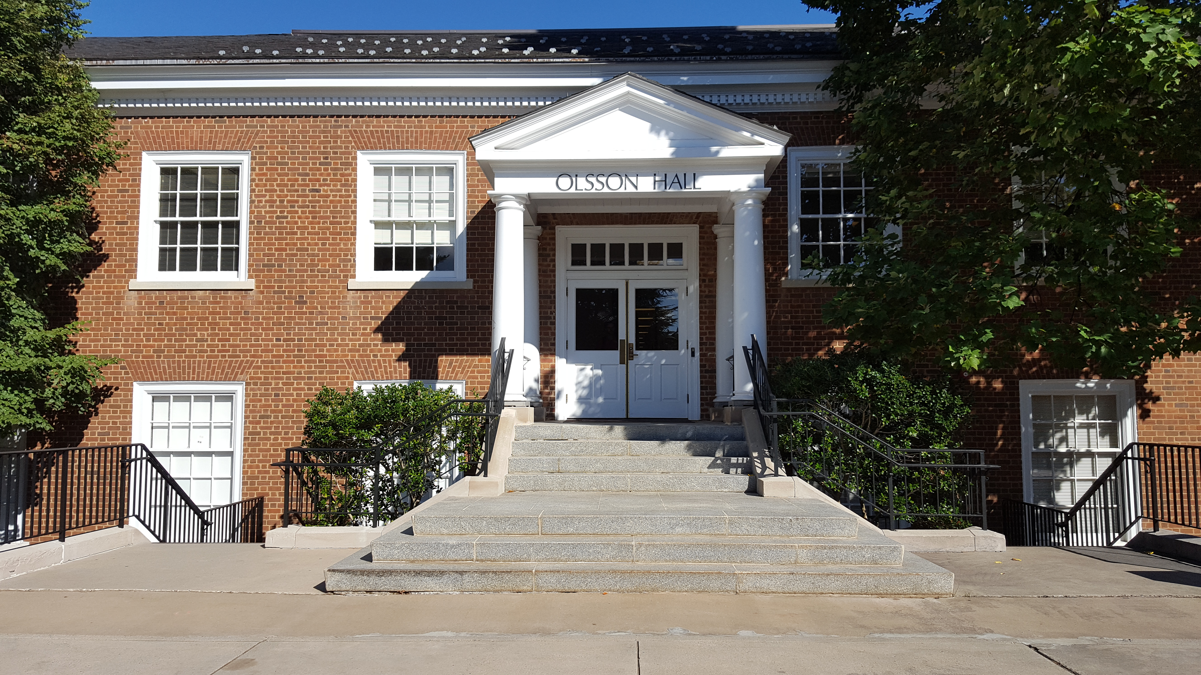
Getting to My Office

Slide 3

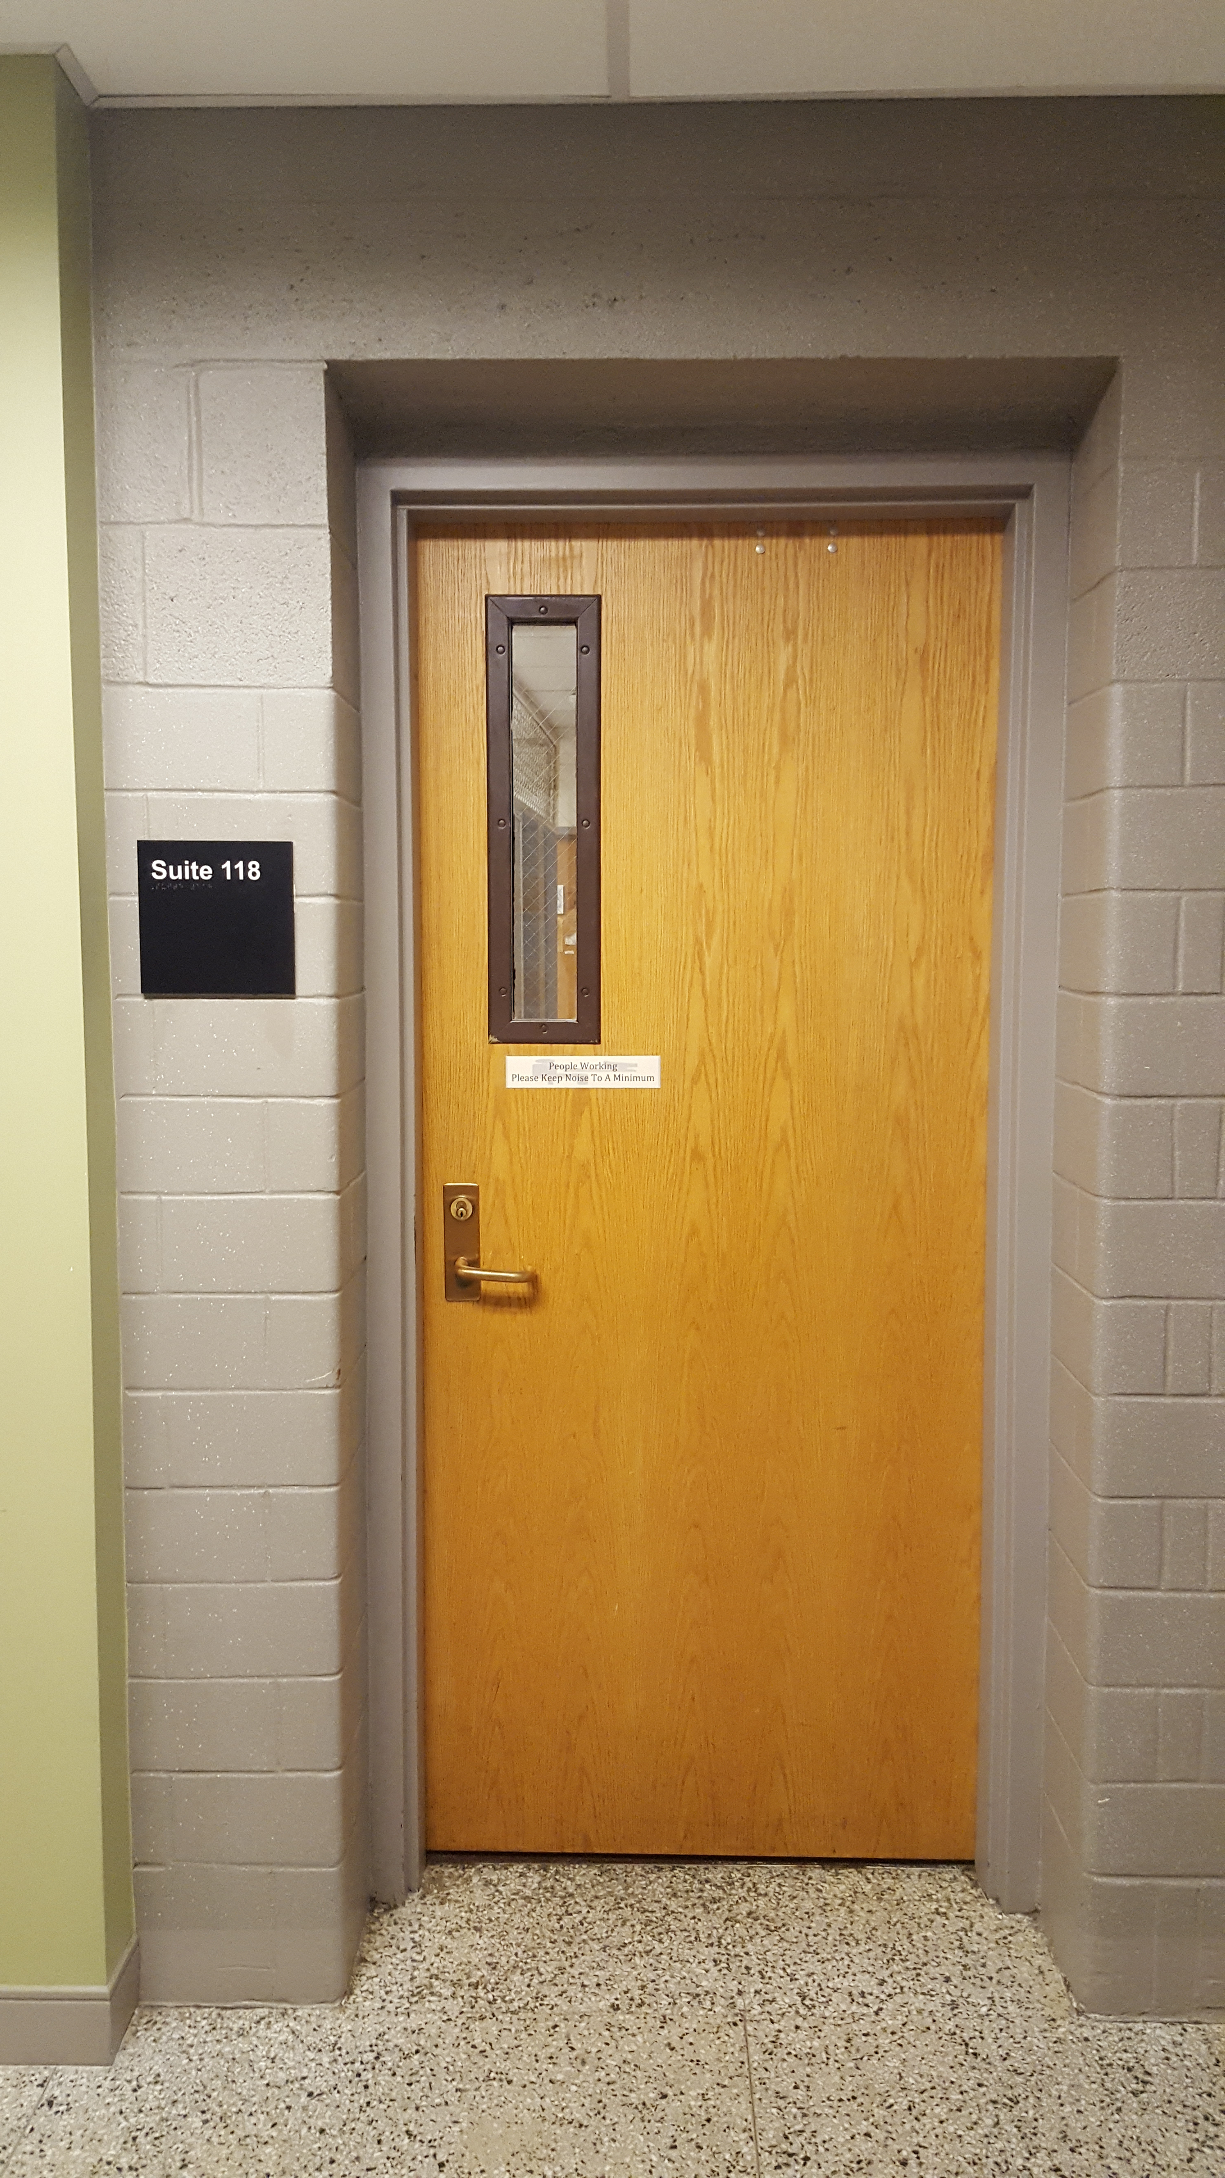
Getting to My Office

Slide 4
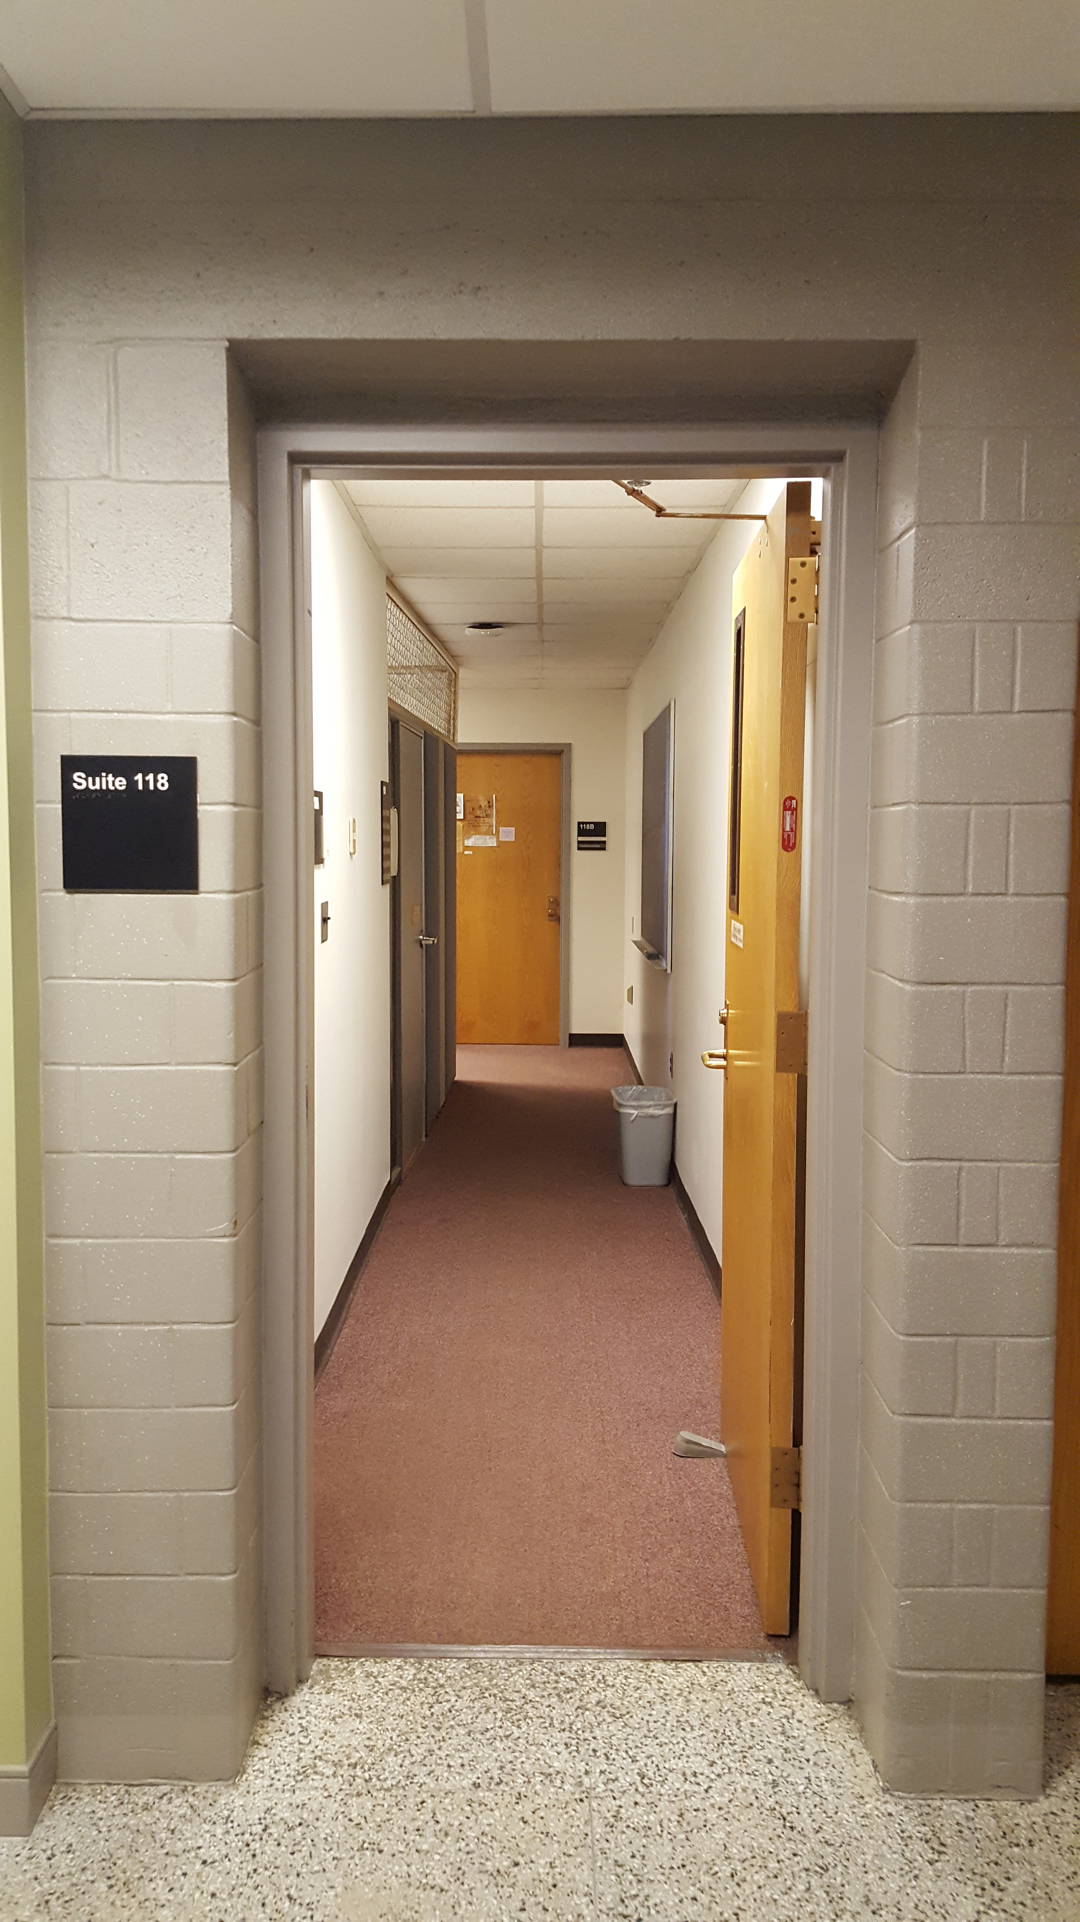
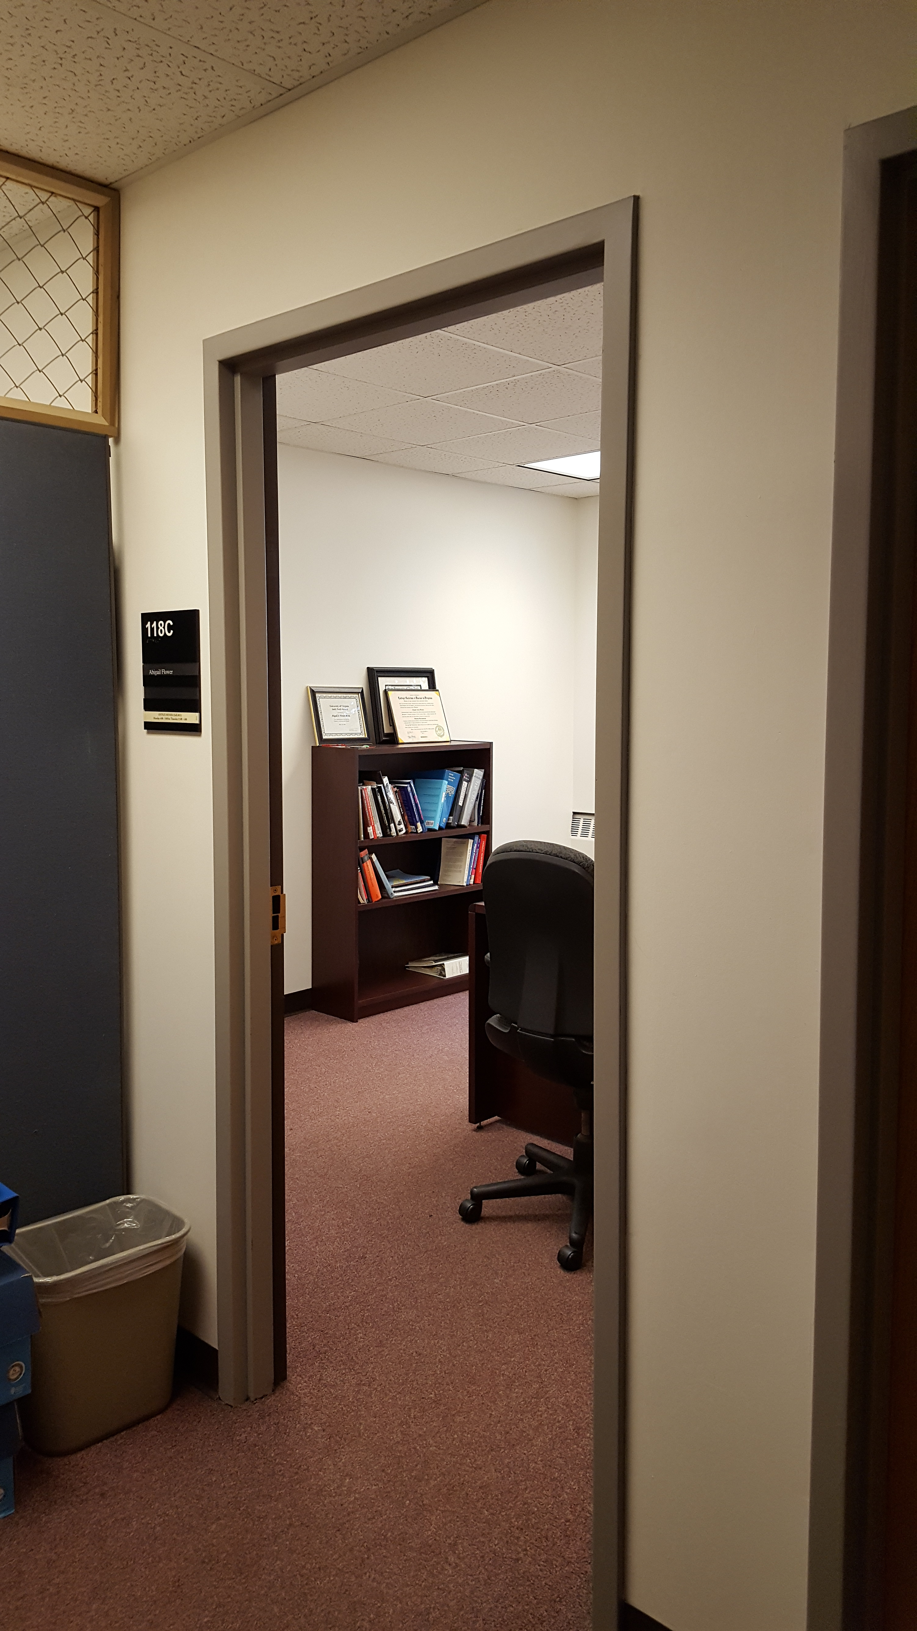
Getting to My Office

Slide 5
Feedback from Last Year
The class is good, but I think I would prefer a class with more practice than theory.
This was one of my favorite courses at UVA, if not my favorite. Professor Flower obviously has a passion for the subject material, and was willing to go above and beyond in making sure everyone understood everything. I would like to see even more theory, though.
My confidence pre and post this class has gone from negative to as high as it can be given my "novice" experience with machine learning and data science, so, a super valuable class. I believe now that I have a chance of being a great data scientist. Nothing is intimidating anymore.

Slide 6
What is data science?
“Data science is the civil engineering of data. Its acolytes possess a practical knowledge of tools and materials, coupled with a theoretical understanding of what’s possible.” – Mike Driscoll, CEO, Metamarket
“One way to consider data science is as an evolutionary step in interdisciplinary fields like business analysis that incorporate computer science, modeling, statistics, analytics, and mathematics.”
-- NYU Data Science

Slide 7
What is a data scientist?
First thing you need to know: you are a chameleon. This requires special skills.
You are responsible for guiding a data science project from start to finish.
A good data scientist must be creative.
Other thoughts:
https://gigaom.com/2014/03/06/data-science-not-a-real-thing-or-a-thing-not-worth-less-than-six-figures/
Notes:
Many different types of data may be brought to your attention. What does this mean?

Slide 8
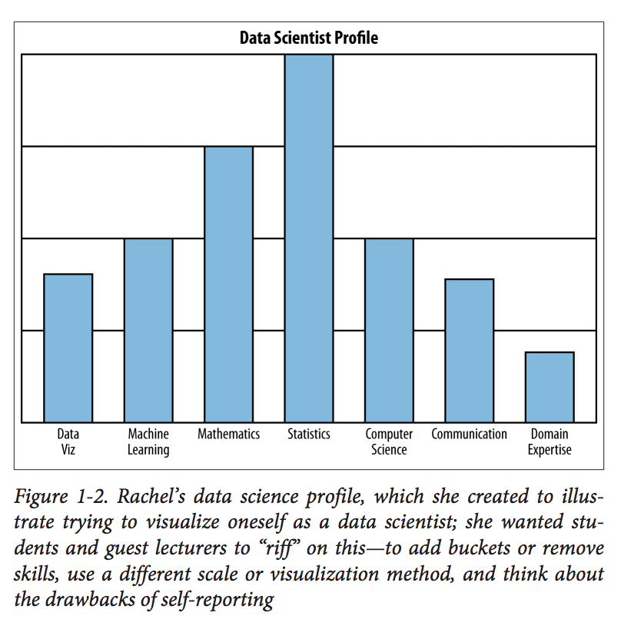
The Data Scientist’s Profile

Slide 9
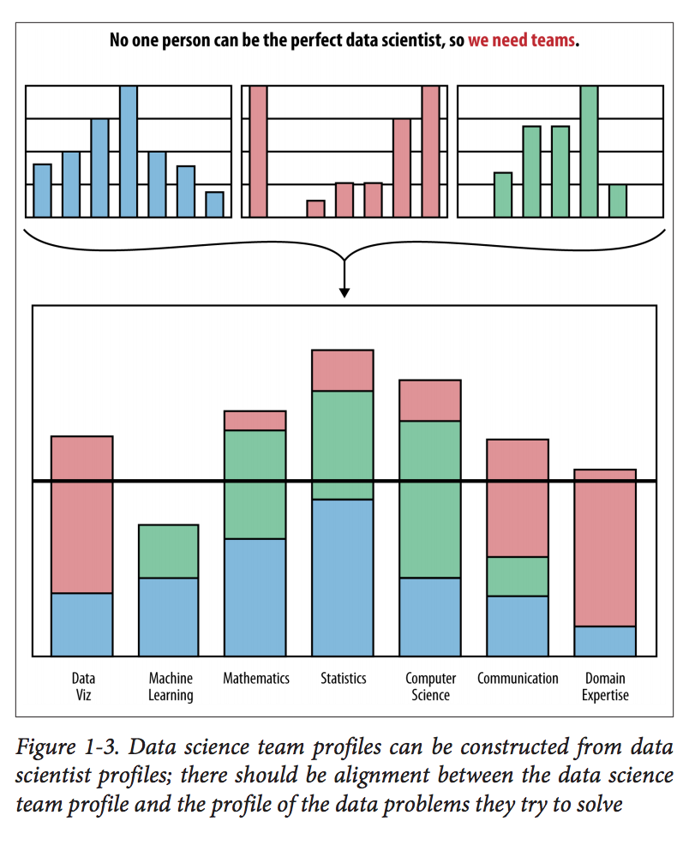
No one person can be the perfect data scientist, so we need teams!
Data science team profiles can be constructed from data scientist profiles; there should be alignment between the data science team profile and the profile of the data problems they try to solve.
Notes:
-

Slide 10
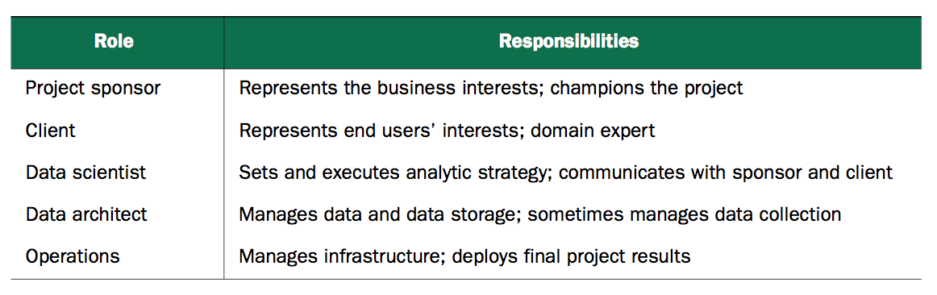
It takes a village: your role in a data science project
Notes:
Project sponsor – keep informed, most important person, represents interst of business, determines whether results are up to snuff
ATTAINING SPONSOR SIGN-OFF IS YOUR CENTRAL GOAL. TO ENSURE THIS, KEEP HIM/HER ENGAGED. ALSO, MAKE SURE THE SPONSOR’S GOAL IS CLEAR, MEASURABLE, DIRECT
Client – who the product or analysis will ultimately benefit

Slide 11
Group Activity
Get into groups of three to four. You have 10 minutes for this exercise. Take a look in the Resources Tab, Folder “Day 1” of our Collab site. Open the DMV document. Read the document. Assign a time keeper, a note taker, and a presenter. Consider and answer the following:
What is the current situation? Would you like to know more? What would you ask your client if you could?
Define a solid, measurable goal that you think would satisfy your client. What is your metric?
What data would you like to have (think big)? How would you get this data? How would it have been gathered (sensors, cameras, etc.)? Would retrospective data likely all have been in the same spot?
What deliverable would you like to hand over to your client at the end of the project (you can think big here – be creative)?

Slide 12
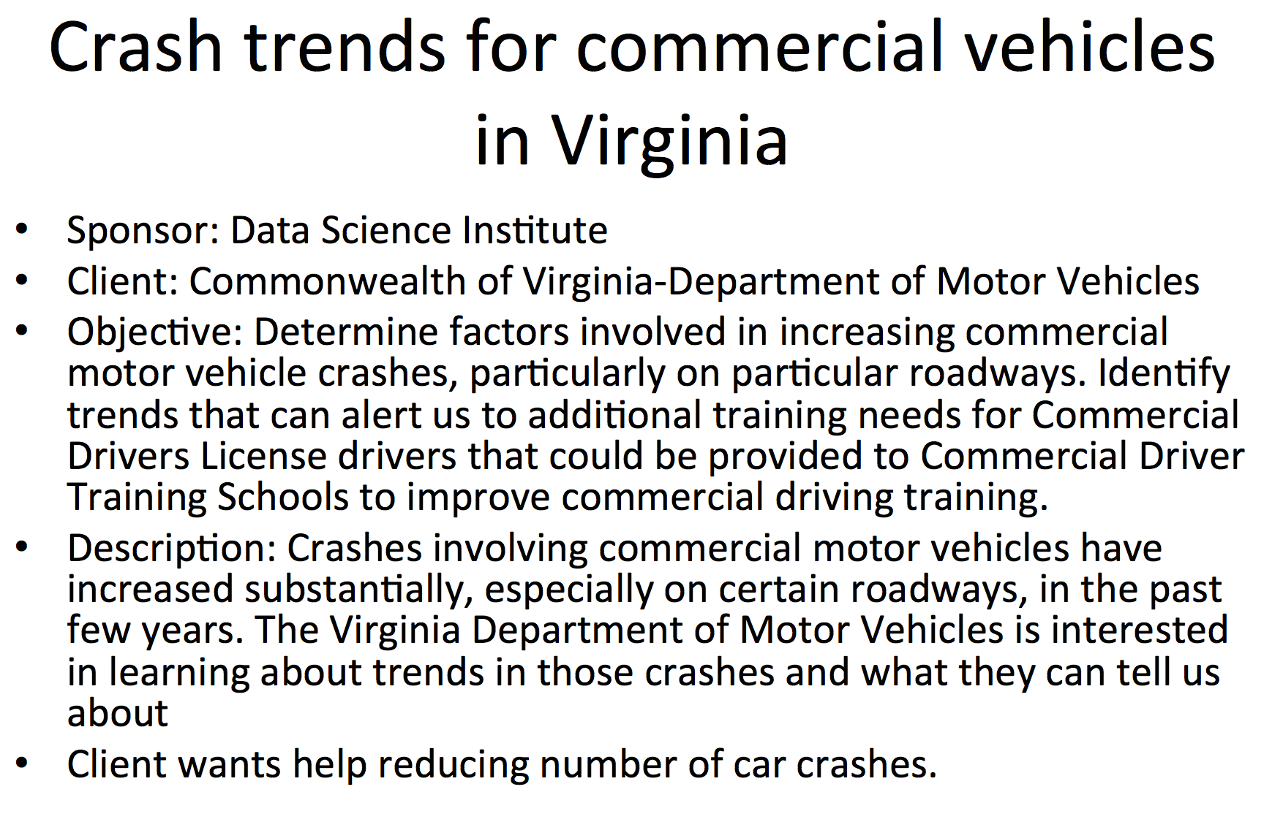

Slide 13
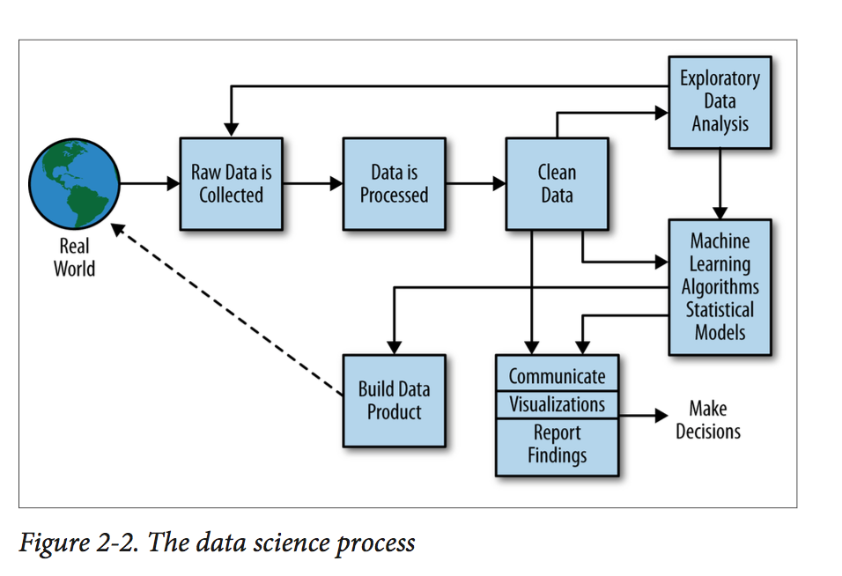
What is the data science process?

Slide 14
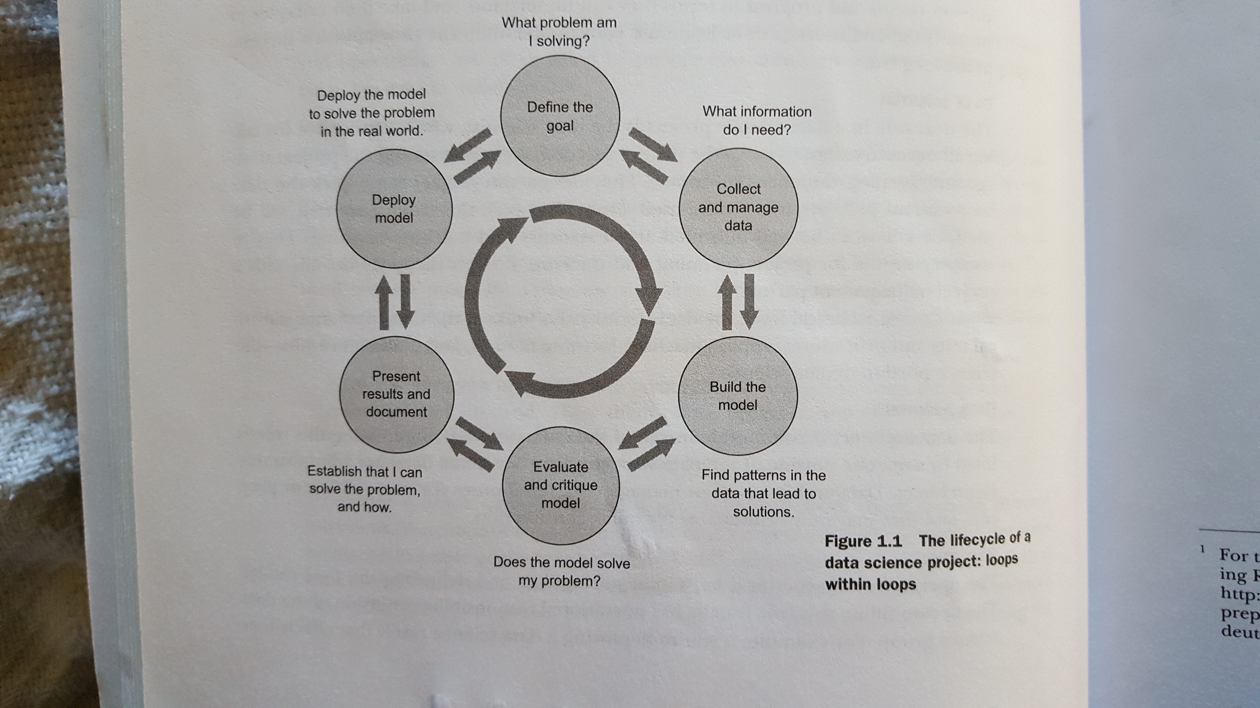
What is the data science process?

Slide 15
Homework Assignment for Next Class (Monday, August 29)
Read Chapter 1: “The data science process” from PDS. Create your own data scientist profile (you can just sketch this by hand).
Install R and RStudio (I will post a video to help you with this, should you require help).

